Slide 1


TOPIC: Reinforcement Learning in Continuous Action Spaces through Sequential Monte Carlo Methods
Advances in Reinforcement Learning
Submitted by: Avinash Kumar Chaurasia
Matriculation Number:- 6896835

Slide 2
Introduction
Reinforcement Learning (RL) is a machine learning technique that allows an agent to learn by trial and error in an interactive environment using feedback from its own actions and experiences.
Some key terms that describe the basic elements of an RL problem are:
Environment — Physical environment in which the agent works.
State — Current situation of the agent.
Reward — Feedback from the environment.
Policy — A method for mapping an agent's state to its actions.
Value — Future reward that an agent would receive by taking an action in a particular state
Figure 1: Super Mario
Source: https://gifer.com/en/6RJw
Source: https://towardsdatascience.com/reinforcement-learning-101-e24b50e1d292

Slide 3
Problem Analysis
RL problems incorporating continuous actions have received little attention.
Small deviations from the ideal course of action result in extremely low utility ratings.
Too expensive for the learning process to use discretization.
Small errors in the estimated value of an action may lead to discontinuous changes in the policy, thus leading to convergence problems.
Source: https://proceedings.neurips.cc/paper/2007/hash/0f840be9b8db4d3fbd5ba2ce59211f55-Abstract.html

Slide 4
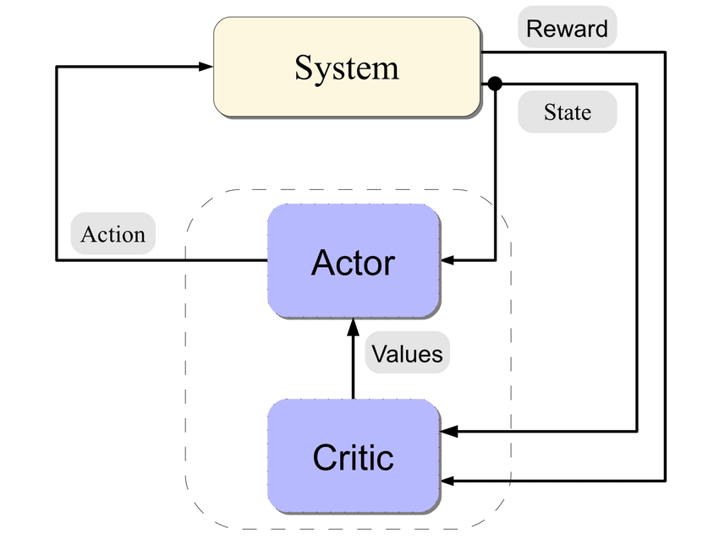
Actor-Critic Architecture
Explicitly represent the policy (stored by the actor) with a memory structure independent of the one used for the value function (stored by the critic).
The actor follows a policy which is probably distribution over the action space.
The critic criticize the actor’s actions based on the estimated value function, and the actor then modifies its policy via a stochastic gradient on its parameter space.
The actor gradually alters its policy so that acts that generate higher utility values are chosen more frequently.
Figure 2: Actor-Critic Architecture
Source: https://www.researchgate.net/figure/The-Actor-Critic-Architecture_fig2_220696313

Slide 5
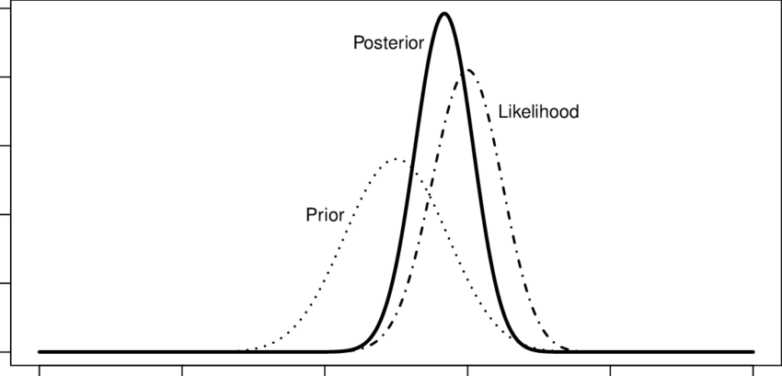
Sequential Monte Carlo Methods
Estimating unknown quantities.
Prior Knowledge of underlying system is available.
Bayesian filtering problem: Prior distribution for the unknown quantities and a likelihood function relating these quantities to the observations.
Sequential Monte Carlo (SMC) methods are a subset of computational algorithms that make numerical estimates of unknown parameters via a process of repeated random sampling. The sampling is propagated over time using a combination of sequential importance sampling, selection/resampling steps.
Figure 3: Bayesian updating of the prior distribution to posterior distribution.
Source: https://www.researchgate.net/figure/Bayesian-updating-of-the-prior-distribution-to-posterior-distribution-The-Posterior_fig1_320507985

Slide 6
Proposed Algorithm
Sequential Monte Carlo (SMC) approach to approximate the sequence of of probability distributions implemented by the actor.
The Actor depicts its stochastic policy with a finite set of random samples (i.e., actions)
Actions are first selected from a prior distribution, and then they are resampled per an importance sampling estimate based on the critic’s learned utility values.
The set of possible actions becomes increasingly more crowded around actions having larger utilities as a result of the resampling and moving steps
Source: https://proceedings.neurips.cc/paper/2007/hash/0f840be9b8db4d3fbd5ba2ce59211f55-Abstract.html

Slide 7
Proposed Algorithm
Initialization
Actor considers a uniform distribution over the action space.
Each sampled action is assigned an importance weight.
Action Selection
The actor randomly selecting one action from those accessible in the current state to select the best possible action in the current state, given the estimated action value function.

Slide 8
Proposed Algorithm
Critic Update
The actor sets the policy, and the critic computes an approximation of the action-value function based on the collected rewards, for each action available in state s.
Actor Update
The Actor updates the importance weights, based on action-values estimated by the critic.
Actions with higher estimates are given more weights.
Resampling is done if some samples have very small or high weights.

Slide 9
Proposed Algorithm
Initialize A(s) from proposal distribution and assign them importance weights
Action Selection
Actor randomly selects one action from those accessible in the current state
Critic Update
Critic updates the action value Q(s_{t}, a_{t})
No
Actor Update
Update Weights according to action-value function
T=N
Weights with high variance
End
Yes
No
Yes
Resampling
Figure 4: SMC Learning Algorithm

Slide 10
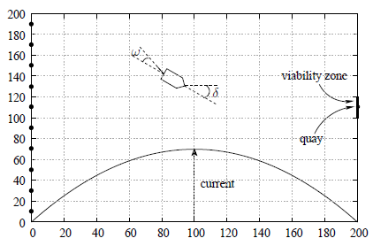
The Boat Problem
The challenge is to learn how to maneuver a boat from a river’s left bank to its right bank wharf while dealing with a strong non-linear stream.
The coordinates of the boat, x, and y, are specified in the range [0,200] while the desired direction U is set in the range [- 90◦,90◦].
Figure 5: The Boat Problem
Source: https://proceedings.neurips.cc/paper/2007/hash/0f840be9b8db4d3fbd5ba2ce59211f55-Abstract.html
Source: https://proceedings.neurips.cc/paper/2007/hash/0f840be9b8db4d3fbd5ba2ce59211f55-Abstract.html

Slide 11
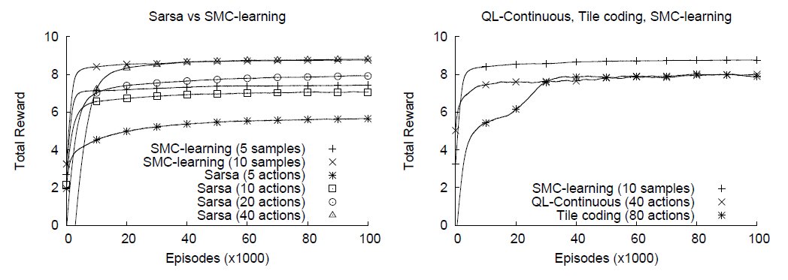
Empirical Results
Figure 6: SMC-learning vs. SARSA (left), SMC-learning vs. tile coding (right), and Continuous Q-learning vs. SMC-learning (right)
Source: https://proceedings.neurips.cc/paper/2007/hash/0f840be9b8db4d3fbd5ba2ce59211f55-Abstract.html
SMC-learning vs SARSA(left), that the performance and convergence time of SMC-learning even with only 5 samples surpasses SARSA with 5 and 10 actions.
On right, SMC-learning outperforms the other two algorithms such as Tile coding and continuous Q-learning.
Source: https://proceedings.neurips.cc/paper/2007/hash/0f840be9b8db4d3fbd5ba2ce59211f55-Abstract.html

Slide 12
Conclusion
It is often impossible to do a full search in a continuous action space to identify the best action.
A novel actor-critic algorithm is proposed to solve the continuous action space problem.
The algorithm is built on a Sequential Monte Carlo approach, which allows the actor to express the current policy using a finite set of potential actions coupled with weights that are updated using the critic’s utility values.
Through a process of importance sampling and resampling, experimental data on Boat problem reveal that SMC-learning is capable of identifying the highest valued behaviors.

Slide 13
My Opinion
SMC algorithm is very effective when it comes to solving continous action space problems.
Several algorithms try mitigating the problem of continous action space in RL problems by limiting their search to a finite number of points.
Algorithms such as tile coding and interpolation-based must make (sometimes implicit) assumptions about the shape of the value function to keep this number low.
SMC-learning, the algorithm does not require any assumptions about the shape of the value function, it is model-free, and it can learn to obey stochastic policies as well (needed in multi-agent problems).

Slide 14


